Slide 1

Northern Europe’s Housing Market
By Shruti Bajpai

Slide 2
Agenda

Slide 3
1
Data Collection, Cleansing & Processing
2
Data Analysis & Dashboard
3
Conclusion

Slide 4
Data Collection, Cleansing & Processing

Slide 5
Data Collection & Cleansing
Data Processing
Goal:
Select factors affecting housing market in Northern Europe & help visualize.
Countries Selected:
Sweden
Denmark
Norway
Finland
Iceland
Period: 2005 – 2019
Source: OECD
Vizualization Method:
Pandas & Dash (Plotly)
NorthernEurope.CSV
GDPNorthernEurope.CSV
Merged:
DF_Info
WorkingPopulation.CSV
HouseholdDisposableIncome.CSV

Slide 6
Data Analysis & Dashboard

Slide 7
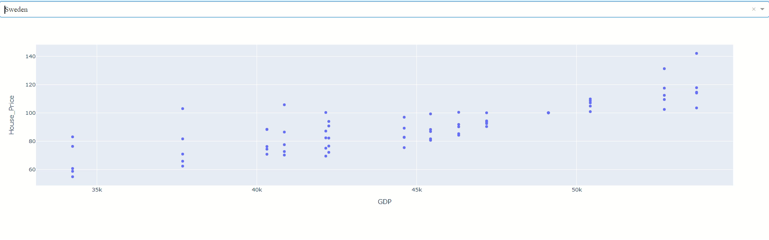
Nominal Price Index vs. GDP

Slide 8
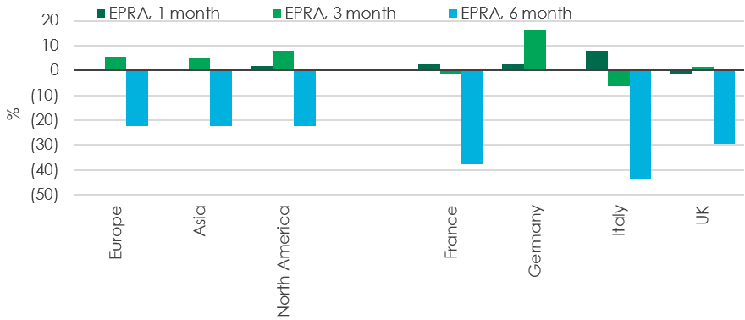
Avg. Working Population
FIGURE 8: REAL ESTATE VERSUS WIDER EQUITY MARKET PERFORMANCE, H1 2020
Age
15 - 64
64.13%
Avg. Household
Disposable Income
*Data not available from public sources. Image obtained from CBRE
*Note that Iceland is excluded due to lack of data provision
Notes:
https://www.cbre.fr/en/research-and-reports/EMEA-Real-Estate-Market-Outlook-2020-Capital-Markets

Slide 9
Conclusion

Slide 10

Northern Europe Housing Market
The economical growth of a country impacts the growth in the housing market
Average Working Population help contribute to the GDP growth
GDP is a helpful indicator, but is too general
Other contributing factors to Investigate would be evaluation of stock markets against news of COVID
Pearson’s Correlations could be utilized to provide indicators of key attributes affecting housing market.

